Slide 1
LESSON 6.2
Balancing Redox Reactions

Slide 2
LESSON GOALS
I can deduce redox half-equations and equations in neutral or acidic conditions

Slide 3
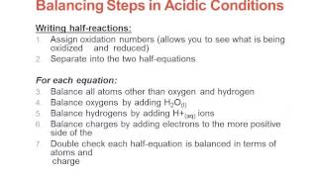
TASK 1: LEARN (MUST DO)
Individually or with a partner:
Watch the Balancing Redox Reactions video
Complete the Guided Note

Slide 4
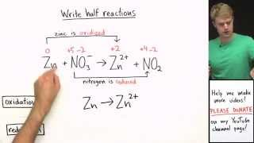
TASK 2: LEARN (ASPIRE TO DO)
You can also balance redox reactions in BASIC conditions; it requires just a couple of extra steps.
You do not need to know how to do this for this course, but if you’re curious, here is a VIDEO to show you how it’s done.

Slide 5
TASK 3: PRACTICE (MUST DO)
Individually or with a partner:
Complete the Balancing Redox Reactions practice
Check your answers when you are done!

Slide 6
TASK 4: MASTERY CHECK (MUST DO)
Individually:
Complete the Balancing Redox Reactions Mastery Check (see me when you are ready!)

